Slide 1

Introduction to Cyclic Codes
Dr. Arup Kumar Pal
Department of Computer Science & Engineering
Indian Institute of Technology (ISM)
Dhanbad, Jharkhand-826004
E-mail: arupkrpal@iitism.ac.in

Slide 2
Cyclic Codes
It is a subclass of Linear Block Codes
Definition:
ie. If C= (C_{n-1,} C_{n-2, …,} C_{2,} C_{1,} C₀) is a code vector,
Then C’=(C_{n-2, …,} C_{2,} C_{1,} C_{0 ,}C_{n-1}) is also a code vector
An (n,k) linear block code C is a cyclic code if every cyclic shift of a codeword in C is also a codeword in C

Slide 3
Algebraic Description of Cyclic Code
Every cyclic codeword can be represented as a polynomial
For an (n,k) cyclic code,
Maximum degree of codeword=n-1
Polynomial representation of C=(c_{n-1, ...,} c_{2,}c_{1,}c₀) is :
c(x)= c_{n-1}x^{n-1} +…+ c₂x² + c₁x + c₀

Slide 4
Cyclic Codes
Non-systematic codeword
c(x) = i(x).g(x)
Systematic codeword
c(x) = x^{n-k} . i(x) + R _{g(x)} x^{n-k} . i(x)
Steps to Find Systematic Codeword:
v(x) = x^{n-k} . i(x)
r(x)= R _{g(x)} x^{n-k} . i(x)
c(x) = v(x) + r(x)
where, g(x) is Generator Polynomial
i(x) is Information Polynomial

Slide 5
Generator Polynomial
Definition:
Maximum degree of g(x)= n-k
Polynomial Representation of g(x):
In an (n,k) cyclic code there exist a unique generator polynomial from which all the codewords can be generated
g(x) = g_{n-k}x^{n-k} + g_{n-k-1}x^{n-k-1} +…+ g₁x + g₀

Slide 6
Theorem 1
The non-zero code polynomial of minimum degree in a cyclic code C is unique
Proof:
Let g(x) and g’(x) be two non-zero code polynomial of minimum degree r=n-k
g(x) = x^{n-k} + g_{n-k-1}x^{n-k-1} +…+ g₁x + 1
g’(x) = x^{n-k} + g’_{n-k-1}x^{n-k-1} +…+ g’₁x + 1
C’(x) = g(x)+g’(x) (By linearity property)
=(g_{n-k-1}+ g’_{n-k-1})x^{n-k-1} +…+ (g₁+g’₁)
C’(x) is a code polynomial of degree < n-k (Contradiction) Hence, g(x) is unique
Assume g(x) is not unique

Slide 7
Theorem 2
Let g(x) = g_{n-k-1}x^{n-k} + g_{n-k-1}x^{n-k-1} +…+ g₁x + g₀
be the nonzero code polynomial of minimum degree in an (n,k) cyclic code C.
Then,
Proof:
Assume g₀=0
g(x) = x^{n-k} + g_{n-k-1}x^{n-k-1} +…+ g₂x² + g₁x
= x(x^{n-k-1} + g_{n-k-1}x^{n-k-2} + … + g₂x + g₁ )
= x C’(x) (Cyclic Shifting)
C’(x) has degree less than n-k (Contradiction)
Hence, g₀≠0 implies g₀=1
The constant term g₀ is equal to 1

Slide 8
Theorem 3
Let g(x) = g_{n-k}x^{n-k} + g_{n-k-1}x^{n-k-1} +…+ g₁x + g₀
be the nonzero code polynomial of minimum degree in an (n,k) cyclic code C
Proof:
Assume v(x) is a codeword such that,
v(x) = a(x)g(x)+b(x) (ie not divisible by g(x))
v’(x) = a(x)g(x)
Therefore v(x)=v’(x)+b(x) ie. b(x)=v(x)+v’(x)
This implies b(x) is a valid codeword (Linearity Property)
But degree(b(x))<degree(g(x)) (Contradiction)
A binary polynomial of degree n−1 or less is a code polynomial iff it is a multiple of g(x)

Slide 9
Theorem 4
In an (n,k) cyclic code, there exists one and only one code polynomial of degree n-k
Proof:
Every code polynomial v(x) is a multiple of g(x)
v(x) = u(x).g(x)
= (u_{k-1}x^{k-1} + … + u₁x + u₀).g(x)
So, an (n,k) cyclic code is completely specified by its non-zero code polynomial of minimum degree g(x), which is the generator polynomial
And the degree of g(x) is equal to the number of parity check digits of the code

Slide 10
Theorem 5
The generator polynomial g(x) of an (n,k) cyclic code, is a factor of x^{n} + 1
Proof:
x^{k} g(x) is a polynomial of degree n
Dividing x^{k} g(x) by x^{n} + 1, we get,
x^{k} g(x) = (x^{n} + 1) + g^{(k)}(x) (Remainder=g^{(k)}(x))
Right circular shift of g(x) k times gives g^{(k)}(x)
So, g^{(k)}(x) = a(x).g(x) (ie. Multiple of g(x))
This implies, x^{n} + 1 ={x^{k} + a(x)}g(x)
Hence g(x) is a factor of x^{n} + 1

Slide 11
Theorem 6
If g(x) is a polynomial of degree n-k & is a factor of x^{n} + 1, then g(x) generates an (n,k) cyclic code
Proof:
Multiples of g(x) of degree n−1 or less generate a (n,k) linear block code.
If v(x) = v_{n-1}x^{n-1} + … + v₁x + v₀
Then x.v(x) = v_{n-1}x^{n} + v_{n-2}x^{n-1} + … + v₁x² + v₀x
= v_{n-1}(x^{n}+1)+(v_{n-2}x^{n-1} +…+v₀x+v_{n-1})
= v_{n-1} (x^{n}+1) + v’(x)
So, v’(x) is also a cyclic code polynomial
This implies, the generated code is cyclic

Slide 12
Generator Matrix
Generator Polynomial
Generator matrix (Non-Systematic Form)
G = g_{n-k} g_{n-k-1} … g₂ g₁ g₀ 0 0 … 0
0 g_{n-k} … g₃ g₂ g₁ g₀ 0 … 0
...
0 0 … 0 g_{n-k} … g₂ g₁ g₀ _{k X n}
It can be reduced to its systematic form G=[I_{k}:P] by row transformations
g(x) = g_{n-k}x^{n-k} + g_{n-k-1}x^{n-k-1} +…+ g₁x + g₀
Note:

Slide 13
Parity Check Matrix
For an (n,k) cyclic code
Parity Check Polynomial
Parity Check matrix
H = h₀ h₁ h_{2 …} h_{k-1} h_{k} 0 … 0
0 h₀ h₁ … h_{k-1} h_{k} 0 … 0
...
0 0 0 … 0 h₀ h₁ … h_{k} _{(n-k) X n}
x^{n}+1 = g(x) h(x)
h(x) = h_{k}x^{k} + h_{k-1}x^{k-1} +…+ h₂x² + h₁x + h₀

Slide 14
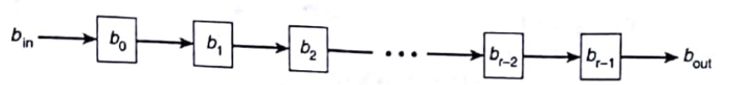
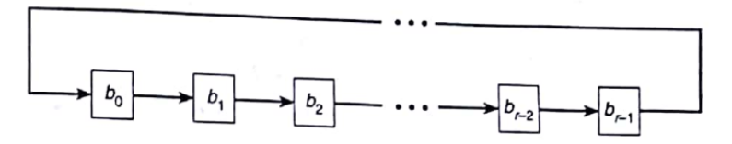
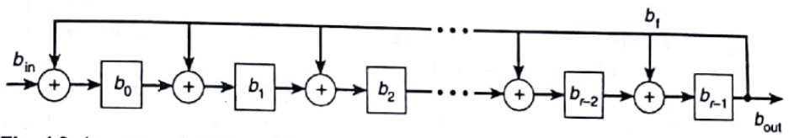
Linear Feedback Shift register
An r-stage shift register
An r-stage linear feedback shift register
An r-stage LFSR with feedback to all stages

Slide 15
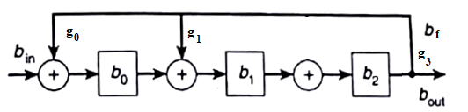
Polynomial Division using LFSR
Let g(x) = x³ + x + 1 = g₀ + g₁x + g₂x² + g₃x³
Then, g₀ = 1, g₁ = 1, g₂ = 0, g₃ = 1
and Degree of r(x) < 3
p(x) = x⁶ + x³ + x + 1=(1001011)₂
b_{out} = b_{f} = b₂
b₂ = b₁
b₁ = b₀ + b_{f}
b₀ = b_{in} + b_{f}
r(x) = b₂x² + b₁x + b₀ = x² + 1
q(x) = x³ + x
Shift | b_{in} | b₀ | b₁ | b₂ | b_{f}
 |  | 0 | 0 | 0 | 0
1 | 1 | 1 | 0 | 0 | 0
2 | 0 | 0 | 1 | 0 | 0
3 | 0 | 0 | 0 | 1 | 0
4 | 1 | 0 | 1 | 0 | 1
5 | 0 | 0 | 0 | 1 | 0
6 | 1 | 0 | 1 | 0 | 1
7 | 1 | 1 | 0 | 1 | 0
Equations:

Slide 16
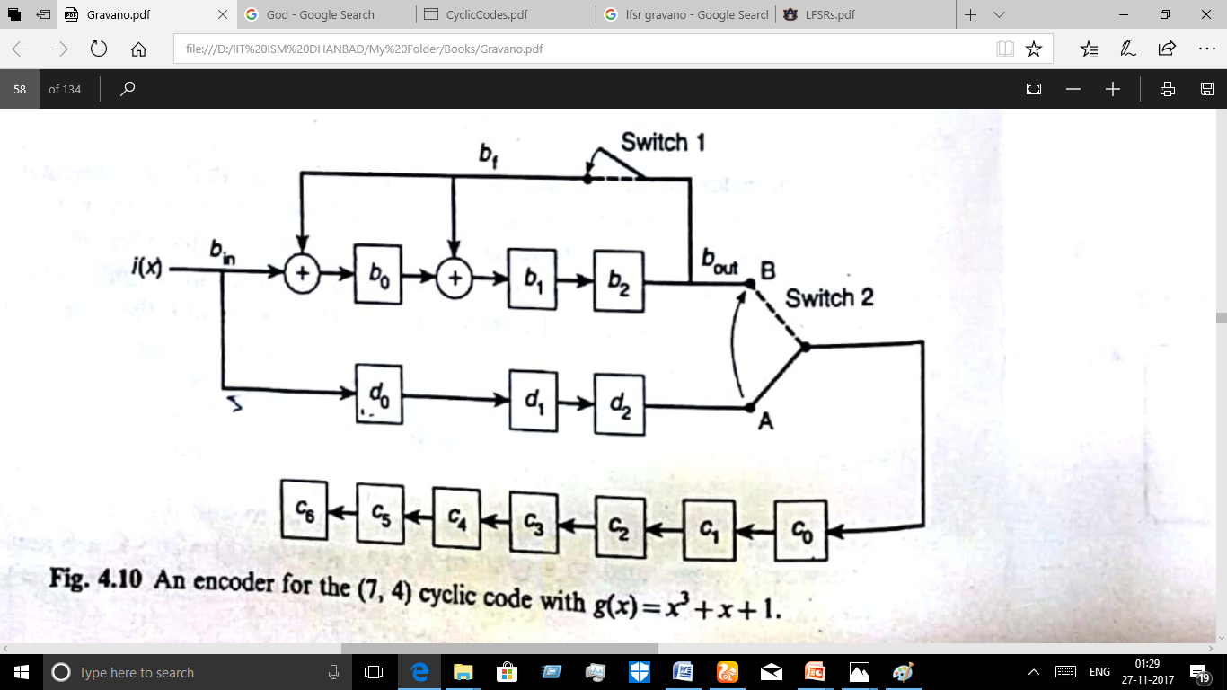
Cyclic code Encoding using LFSR(Lower Order)
For (7,4) cyclic code,
g(x) = x³ + x + 1
i(x) = x³ + x
Equations:
b_{out} = b_{f} = b₂
b₂ = b₁
b₁ = b₀ + b_{f}
b₀ = b_{in} + b_{f}
d₂ = d₁
d₁ = d₀
d₀ = b_{in}
c_{i} = c_{i-1} i≠0
c₀ = d₂ (Till Shift 7)
c₀ = b₂ (After Shift 7)
c(x) = x⁶ + x⁴ + x+1
No. of shifts = 2n-k
Shift | b_{in} | b₀ | b₁ | b₂ | b_{f} | d₀ | d₁ | d₂ | c₀ | c₁ | c₂ | c₃ | c₄ | c₅ | c₆
 |  | 0 | 0 | 0 | 0 | 0 | 0 | 0 | 0 | 0 | 0 | 0 | 0 | 0 | 0
1 | 1 | 1 | 0 | 0 | 0 | 1 | 0 | 0 | 0 | 0 | 0 | 0 | 0 | 0 | 0
2 | 0 | 0 | 1 | 0 | 0 | 0 | 1 | 0 | 0 | 0 | 0 | 0 | 0 | 0 | 0
3 | 1 | 1 | 0 | 1 | 0 | 1 | 0 | 1 | 0 | 0 | 0 | 0 | 0 | 0 | 0
4 | 0 | 1 | 0 | 0 | 1 | 0 | 1 | 0 | 1 | 0 | 0 | 0 | 0 | 0 | 0
5 |  | 0 | 1 | 0 | 0 | 0 | 0 | 1 | 0 | 1 | 0 | 0 | 0 | 0 | 0
6 |  | 0 | 0 | 1 | 0 | 0 | 0 | 0 | 1 | 0 | 1 | 0 | 0 | 0 | 0
7 |  | 1 | 1 | 0 | 1 | 0 | 0 | 0 | 0 | 1 | 0 | 1 | 0 | 0 | 0
8 |  | 0 | 1 | 1 |  |  |  |  | 0 | 0 | 1 | 0 | 1 | 0 | 0
9 |  | 0 | 0 | 1 |  |  |  |  | 1 | 0 | 0 | 1 | 0 | 1 | 0
10 |  | 0 | 0 | 0 |  |  |  |  | 1 | 1 | 0 | 0 | 1 | 0 | 1

Slide 17
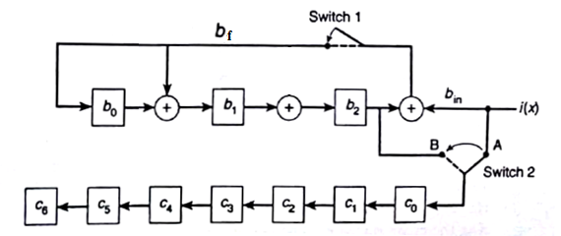
Cyclic code Encoding using LFSR(Higher Order)
For (7,4) cyclic code,
g(x) = x³ + x + 1
i(x) = x³ + x
Equations:
b_{out} = b_{f} = b₂+ b_{in}
b₂ = b₁
b₁ = b₀ + b_{f}
b₀ = b_{f}
c_{i} = c_{i-1} i≠0
c₀ = b₂
c(x) = x⁶ + x⁴ + x+1
No. of shifts = n-k
Shift | b_{in} | b₀ | b₁ | b₂ | b_{f} | c₀ | c₁ | c₂ | c₃ | c₄ | c₅ | c₆
 |  | 0 | 0 | 0 | 0 | 0 | 0 | 0 | 0 | 0 | 0 | 0
1 | 1 | 1 | 1 | 0 | 1 | 1 | 0 | 0 | 0 | 0 | 0 | 0
2 | 0 | 0 | 1 | 1 | 0 | 0 | 1 | 0 | 0 | 0 | 0 | 0
3 | 1 | 0 | 0 | 1 | 0 | 1 | 0 | 1 | 0 | 0 | 0 | 0
4 | 0 | 1 | 1 | 0 | 1 | 0 | 1 | 0 | 1 | 0 | 0 | 0
5 |  | 0 | 1 | 1 |  | 0 | 0 | 1 | 0 | 1 | 0 | 0
6 |  | 0 | 0 | 1 |  | 1 | 0 | 0 | 1 | 0 | 1 | 0
10 |  | 0 | 0 | 0 |  | 1 | 1 | 0 | 0 | 1 | 0 | 1

Slide 18
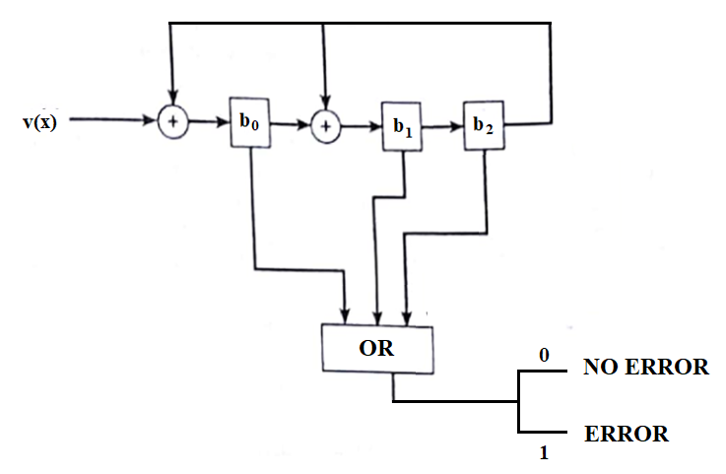
Cyclic Code Decoding using LFSR
Recieved codeword = v(x)
Syndrome = s(x) = R_{g(x)} v(x)
If s(x)==0 then No Error
Else Error
For (7,4) cyclic code,
g(x) = x³ + x + 1
v(x) = x⁶ + x³ + 1
s(x) = x² + x + 1 =(1 1 1)₂
If OR (syndrome bits) == 0 then No Error
Else Error
ie. OR (1 1 1) = 1 or 1 or 1 = 1 implies Error
Detecting condition
Figure. An Error Detection Decoder
Realisation condition

Slide 19
Cyclic Code Error Correction Process
Received codeword = v(x)
v(x) = c(x) + e(x)
Codeword is always divisible by generator polynomial
R_{g(x)} c(x) = 0
Syndrome = s(x) = R_{g(x)} v(x)
s(x) = R_{g(x)} [c(x) + e(x)]
s(x) = R_{g(x)} e(x)
Syndrome solely depends on error pattern
Corrected Codeword = c(x) =v(x) + e(x)
Note

Slide 20
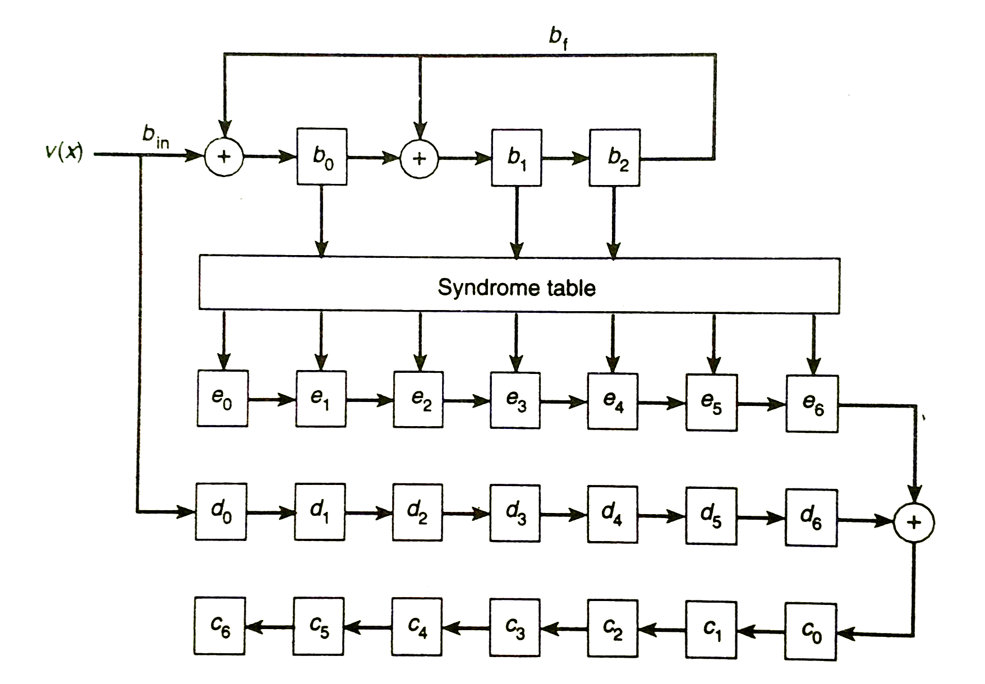
Syndrome Table based Error Detection and Correction
Considering(7,4) cyclic code,
g(x) = x³ + x + 1
Syndrome table needs to be stored
in the memory
Figure. An Error-Correction Decoder for (7,4) cyclic code

Slide 21
Syndrome Table based Error Detection and Correction
For an (7,4) cyclic code, with g(x) = x³ + x + 1
Input: v(x) = x⁶ + x⁴ + x³ + x + 1
Shift | b_{in} | b₀ | b₁ | b₂ | b_{f} | e₀ | e₁ | e₂ | e₃ | e₄ | e₅ | e₆ | d₀ | d₁ | d₂ | d₃ | d₄ | d₅ | d₆ | c₀ | c₁ | c₂ | c₃ | c₄ | c₅ | c₆
 |  | 0 | 0 | 0 | 0 | 0 | 0 | 0 | 0 | 0 | 0 | 0 | 0 | 0 | 0 | 0 | 0 | 0 | 0 | 0 | 0 | 0 | 0 | 0 | 0 | 0
1 | 1 | 1 | 0 | 0 | 0 | 0 | 0 | 0 | 0 | 0 | 0 | 0 | 1 | 0 | 0 | 0 | 0 | 0 | 0 | 0 | 0 | 0 | 0 | 0 | 0 | 0
2 | 0 | 0 | 1 | 0 | 0 | 0 | 0 | 0 | 0 | 0 | 0 | 0 | 0 | 1 | 0 | 0 | 0 | 0 | 0 | 0 | 0 | 0 | 0 | 0 | 0 | 0
3 | 1 | 1 | 0 | 1 | 0 | 0 | 0 | 0 | 0 | 0 | 0 | 0 | 1 | 0 | 1 | 0 | 0 | 0 | 0 | 0 | 0 | 0 | 0 | 0 | 0 | 0
4 | 1 | 0 | 0 | 0 | 1 | 0 | 0 | 0 | 0 | 0 | 0 | 0 | 1 | 1 | 0 | 1 | 0 | 0 | 0 | 0 | 0 | 0 | 0 | 0 | 0 | 0
5 | 0 | 0 | 0 | 0 | 0 | 0 | 0 | 0 | 0 | 0 | 0 | 0 | 0 | 1 | 1 | 0 | 1 | 0 | 0 | 0 | 0 | 0 | 0 | 0 | 0 | 0
6 | 1 | 1 | 0 | 0 | 0 | 0 | 0 | 0 | 0 | 0 | 0 | 0 | 1 | 0 | 1 | 1 | 0 | 1 | 0 | 0 | 0 | 0 | 0 | 0 | 0 | 0
7 | 1 | 1 | 1 | 0 | 0 | 0 | 0 | 0 | 1 | 0 | 0 | 0 | 1 | 1 | 0 | 1 | 1 | 0 | 1 | 0 | 0 | 0 | 0 | 0 | 0 | 0
8 |  |  |  |  |  | 0 | 0 | 0 | 0 | 1 | 0 | 0 | 0 | 1 | 1 | 0 | 1 | 1 | 0 | 1 | 0 | 0 | 0 | 0 | 0 | 0
9 |  |  |  |  |  | 0 | 0 | 0 | 0 | 0 | 1 | 0 | 0 | 0 | 1 | 1 | 0 | 1 | 1 | 0 | 1 | 0 | 0 | 0 | 0 | 0
10 |  |  |  |  |  | 0 | 0 | 0 | 0 | 0 | 0 | 1 | 0 | 0 | 0 | 1 | 1 | 0 | 1 | 1 | 0 | 1 | 0 | 0 | 0 | 0
11 |  |  |  |  |  | 0 | 0 | 0 | 0 | 0 | 0 | 0 | 0 | 0 | 0 | 0 | 1 | 1 | 0 | 0 | 1 | 0 | 1 | 0 | 0 | 0
12 |  |  |  |  |  | 0 | 0 | 0 | 0 | 0 | 0 | 0 | 0 | 0 | 0 | 0 | 0 | 1 | 1 | 0 | 0 | 1 | 0 | 1 | 0 | 0
13 |  |  |  |  |  | 0 | 0 | 0 | 0 | 0 | 0 | 0 | 0 | 0 | 0 | 0 | 0 | 0 | 1 | 1 | 0 | 0 | 1 | 0 | 1 | 0
14 |  |  |  |  |  | 0 | 0 | 0 | 0 | 0 | 0 | 0 | 0 | 0 | 0 | 0 | 0 | 0 | 0 | 1 | 1 | 0 | 0 | 1 | 0 | 1

Slide 22
Meggitt Decoder
Avoids the need for a syndrome table (Main Advantage)
Computes error syndromes of all correctable error patterns from a small number of error syndromes
For single error correcting codes all syndromes can be determined from any one error syndrome
For an (n,k) cyclic code with generator polynomial g(x)
e(x) = Error pattern for error at 4th bit from MSB
e’(x) = Error pattern for error at 5th bit from MSB
s(x) = R_{g(x)} e(x)
s’(x) = R_{g(x)} e’(x)
Relation between e(x) and e’(x) e’(x) = x . e(x)
Relation between s(x) and s’(x)
s’(x) = R_{g(x)} [x . e(x)] = R_{g(x)} [x . s(x)]
s”(x) = R_{g(x)} [x . S’(x)] = R_{g(x)} [x². s(x)]

Slide 23
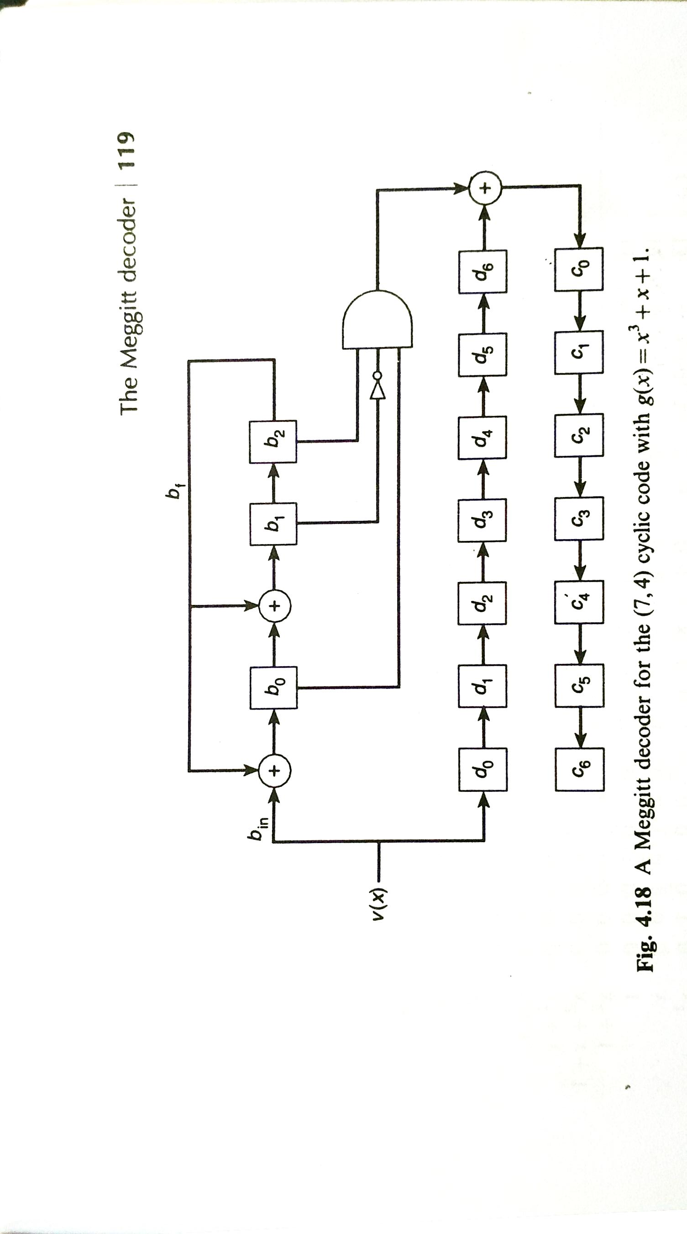
Meggitt Decoder with Lower Order Input
For (7,4) cyclic code, g(x) = x³ + x + 1
Designing decoder with single-bit error correction capability
Considering the HIGHEST ERROR PATTERN ie. x⁶
Syndrome for x⁶ is s_{d}(x) = R_{g(x)} x⁶ = x² + 1
Actual syndrome = s(x) = R_{g(x)} v(x)
At SHIFT 7
If s(x) = = s_{d}(x)
c₀=d₆ +1
Else
c₀=d₆ +0
At SHIFT 7
At SHIFT 8
If s'(x) = = s_{d}(x)
c₁=d₅+1
Else
c₁=d₅ +0
...

Slide 24
Meggitt Decoder with Lower Order Input
For an (7,4) cyclic code, with g(x) = x³ + x + 1
Input: v(x) = x⁶ + x⁴ + x³ + x + 1
Shift | b_{in} | b₀ | b₁ | b₂ | b_{f} | s_{d} | d₀ | d₁ | d₂ | d₃ | d₄ | d₅ | d₆ | c₀ | c₁ | c₂ | c₃ | c₄ | c₅ | c₆ | s(x)
 |  | 0 | 0 | 0 | 0 |  | 0 | 0 | 0 | 0 | 0 | 0 | 0 | 0 | 0 | 0 | 0 | 0 | 0 | 0 | 0
1 | 1 | 1 | 0 | 0 | 0 |  | 1 | 0 | 0 | 0 | 0 | 0 | 0 | 0 | 0 | 0 | 0 | 0 | 0 | 0 | 1
2 | 0 | 0 | 1 | 0 | 0 |  | 0 | 1 | 0 | 0 | 0 | 0 | 0 | 0 | 0 | 0 | 0 | 0 | 0 | 0 | x
3 | 1 | 1 | 0 | 1 | 0 |  | 1 | 0 | 1 | 0 | 0 | 0 | 0 | 0 | 0 | 0 | 0 | 0 | 0 | 0 | x² + 1
4 | 1 | 0 | 0 | 0 | 1 |  | 1 | 1 | 0 | 1 | 0 | 0 | 0 | 0 | 0 | 0 | 0 | 0 | 0 | 0 | 0
5 | 0 | 0 | 0 | 0 | 0 |  | 0 | 1 | 1 | 0 | 1 | 0 | 0 | 0 | 0 | 0 | 0 | 0 | 0 | 0 | 0
6 | 1 | 1 | 0 | 0 | 0 |  | 1 | 0 | 1 | 1 | 0 | 1 | 0 | 0 | 0 | 0 | 0 | 0 | 0 | 0 | 1
7 | 1 | 1 | 1 | 0 | 0 | 0 | 1 | 1 | 0 | 1 | 1 | 0 | 1 | 0 | 0 | 0 | 0 | 0 | 0 | 0 | x + 1
8 |  | 0 | 1 | 1 | 0 | 0 | 0 | 1 | 1 | 0 | 1 | 1 | 0 | 1 | 0 | 0 | 0 | 0 | 0 | 0 | x² + x
9 |  | 1 | 1 | 1 | 1 | 0 | 0 | 0 | 1 | 1 | 0 | 1 | 1 | 0 | 1 | 0 | 0 | 0 | 0 | 0 | x²+x+1
10 |  | 1 | 0 | 1 | 1 | 1 | 0 | 0 | 0 | 1 | 1 | 0 | 1 | 1 | 0 | 1 | 0 | 0 | 0 | 0 | x² + 1
11 |  | 1 | 0 | 0 | 1 | 0 | 0 | 0 | 0 | 0 | 1 | 1 | 0 | 0 | 1 | 0 | 1 | 0 | 0 | 0 | 1
12 |  | 0 | 1 | 0 | 0 | 0 | 0 | 0 | 0 | 0 | 0 | 1 | 1 | 0 | 0 | 1 | 0 | 1 | 0 | 0 | x
13 |  | 0 | 0 | 1 | 1 | 0 | 0 | 0 | 0 | 0 | 0 | 0 | 1 | 1 | 0 | 0 | 1 | 0 | 1 | 0 | x²
14 |  | 1 | 1 | 0 | 1 | 0 | 0 | 0 | 0 | 0 | 0 | 0 | 0 | 1 | 1 | 0 | 0 | 1 | 0 | 1 | x + 1

Slide 25
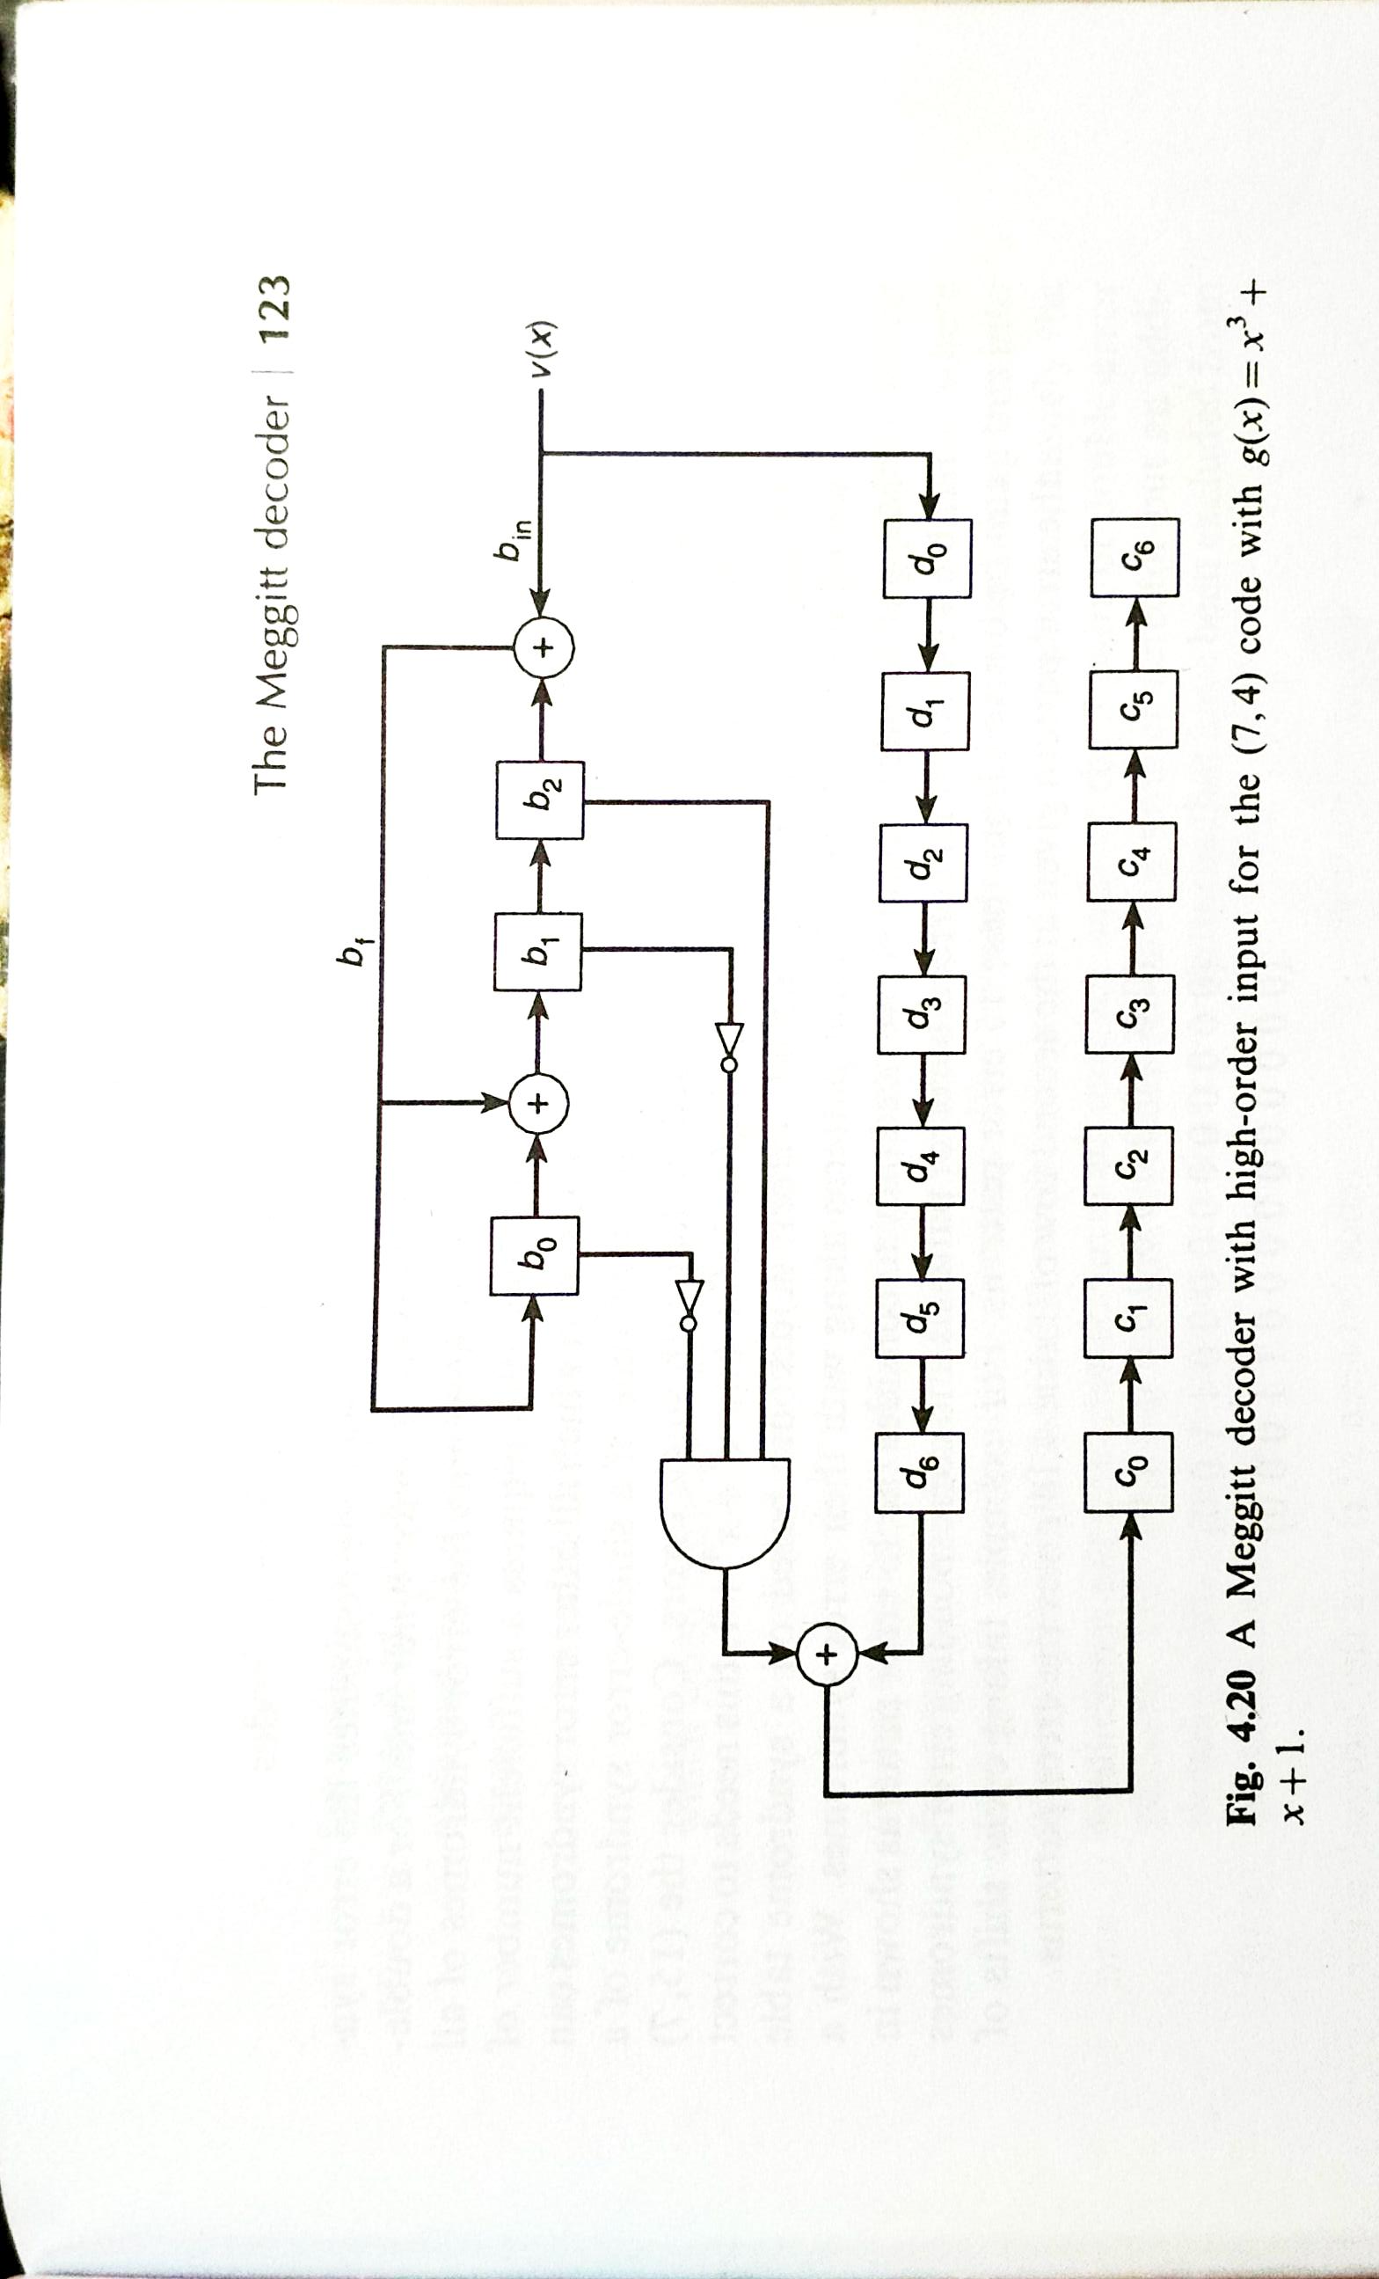
Meggitt Decoder with Higher Order LFSR
For (7,4) cyclic code, g(x) = x³ + x + 1
Considering the HIGHEST ERROR PATTERN ie. x⁶
Syndrome for x⁶ is s_{d}(x) = R_{g(x)} x⁶
Syndrome for x⁶ for higher order input = s’_{d}(x) = R_{g(x)} x^{n-k} x⁶
= R_{g(x)} x³ x⁶ = x²
Normal error syndrome = s(x) = R_{g(x)} v(x)
Error syndrome for higher order input = s’(x) = R_{g(x)}[x^{n-k} v(x)]
Figure. A Meggitt Decoder with higher order input for (7,4) cyclic code

Slide 26
Meggitt Decoder with Higher Order LFSR
For an (7,4) cyclic code, with g(x) = x³ + x + 1
Input: v(x) = x⁶ + x⁴ + x³ + x + 1
Shift | b_{in} | b₀ | b₁ | b₂ | b_{f} | s_{d} | d₀ | d₁ | d₂ | d₃ | d₄ | d₅ | d₆ | c₀ | c₁ | c₂ | c₃ | c₄ | c₅ | c₆ | s(x)
 |  | 0 | 0 | 0 | 0 |  | 0 | 0 | 0 | 0 | 0 | 0 | 0 | 0 | 0 | 0 | 0 | 0 | 0 | 0 | 0
1 | 1 | 1 | 1 | 0 | 1 |  | 1 | 0 | 0 | 0 | 0 | 0 | 0 | 0 | 0 | 0 | 0 | 0 | 0 | 0 | x + 1
2 | 0 | 0 | 1 | 1 | 0 |  | 0 | 1 | 0 | 0 | 0 | 0 | 0 | 0 | 0 | 0 | 0 | 0 | 0 | 0 | x² + x
3 | 1 | 0 | 0 | 1 | 0 |  | 1 | 0 | 1 | 0 | 0 | 0 | 0 | 0 | 0 | 0 | 0 | 0 | 0 | 0 | x²
4 | 1 | 0 | 0 | 0 | 0 |  | 1 | 1 | 0 | 1 | 0 | 0 | 0 | 0 | 0 | 0 | 0 | 0 | 0 | 0 | 0
5 | 0 | 0 | 0 | 0 | 0 |  | 0 | 1 | 1 | 0 | 1 | 0 | 0 | 0 | 0 | 0 | 0 | 0 | 0 | 0 | 0
6 | 1 | 1 | 1 | 0 | 1 |  | 1 | 0 | 1 | 1 | 0 | 1 | 0 | 0 | 0 | 0 | 0 | 0 | 0 | 0 | x + 1
7 | 1 | 1 | 0 | 1 | 1 | 0 | 1 | 1 | 0 | 1 | 1 | 0 | 1 | 0 | 0 | 0 | 0 | 0 | 0 | 0 | x² + 1
8 |  | 1 | 0 | 0 | 1 | 0 | 0 | 1 | 1 | 0 | 1 | 1 | 0 | 1 | 0 | 0 | 0 | 0 | 0 | 0 | 1
9 |  | 0 | 1 | 0 | 0 | 0 | 0 | 0 | 1 | 1 | 0 | 1 | 1 | 0 | 1 | 0 | 0 | 0 | 0 | 0 | x
10 |  | 0 | 0 | 1 | 0 | 1 | 0 | 0 | 0 | 1 | 1 | 0 | 1 | 1 | 0 | 1 | 0 | 0 | 0 | 0 | x²
11 |  | 1 | 1 | 0 | 1 | 0 | 0 | 0 | 0 | 0 | 1 | 1 | 0 | 0 | 1 | 0 | 1 | 0 | 0 | 0 | x + 1
12 |  | 0 | 1 | 1 | 0 | 0 | 0 | 0 | 0 | 0 | 0 | 1 | 1 | 0 | 0 | 1 | 0 | 1 | 0 | 0 | x² + x
13 |  | 1 | 1 | 1 | 1 | 0 | 0 | 0 | 0 | 0 | 0 | 0 | 1 | 1 | 0 | 0 | 1 | 0 | 1 | 0 | x² +x+1
14 |  | 1 | 0 | 1 | 1 | 0 | 0 | 0 | 0 | 0 | 0 | 0 | 0 | 1 | 1 | 0 | 0 | 1 | 0 | 1 | x² + x

